Slide 1
Unit 1 Introduction
Kapil@nast.edu.np

Slide 2
Contents
Database Management System purpose and applications,
Database Systems vs File Systems, Storage Management and Indexing
View of Data- Data Abstraction (Physical, logical and view level, Data Independence)
Instances and Schemas,
Database Languages (DDL, DML and DCL)
Database and Application Architecture- Database System Architecture and Database Application Architecture (two-tier and three-tier)

Slide 3
Concept and Application
Data : Collection of facts, such as numbers, words, measurements, observations or just descriptions of things.
Data are raw facts.
They are meaningless until they are sorted.
After data processing, we get meaningful facts is called Information.
Talking in terms of computing, data is basically information that can be translated into a particular form for efficient movement and processing.
Example: Name, age, weight, height, etc.

Slide 4
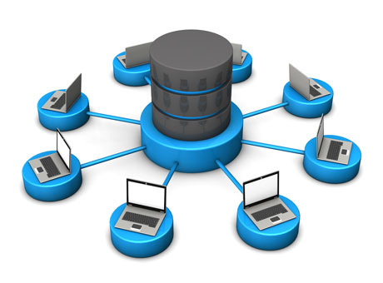
Database
Database is an organized collection of structured data to make it easily accessible, manageable and update.
In simple words, you can say, a database in a place where the data is stored.
Database is collection of related data.
Example: Library
The library contains a huge collection of books of different genres, here the library is database and books are the data.
Notes:
A database is an organized collection of structured information, or data, typically stored electronically in a computer system.
A database-management system (DBMS) is a collection of interrelated data and a set of programs to access those data. Together, the data and the DBMS, along with the applications that are associated with them, are referred to as a database system. The primary goal of a DBMS is to provide a way to store and retrieve database information that is both convenient and efficient.

Slide 5
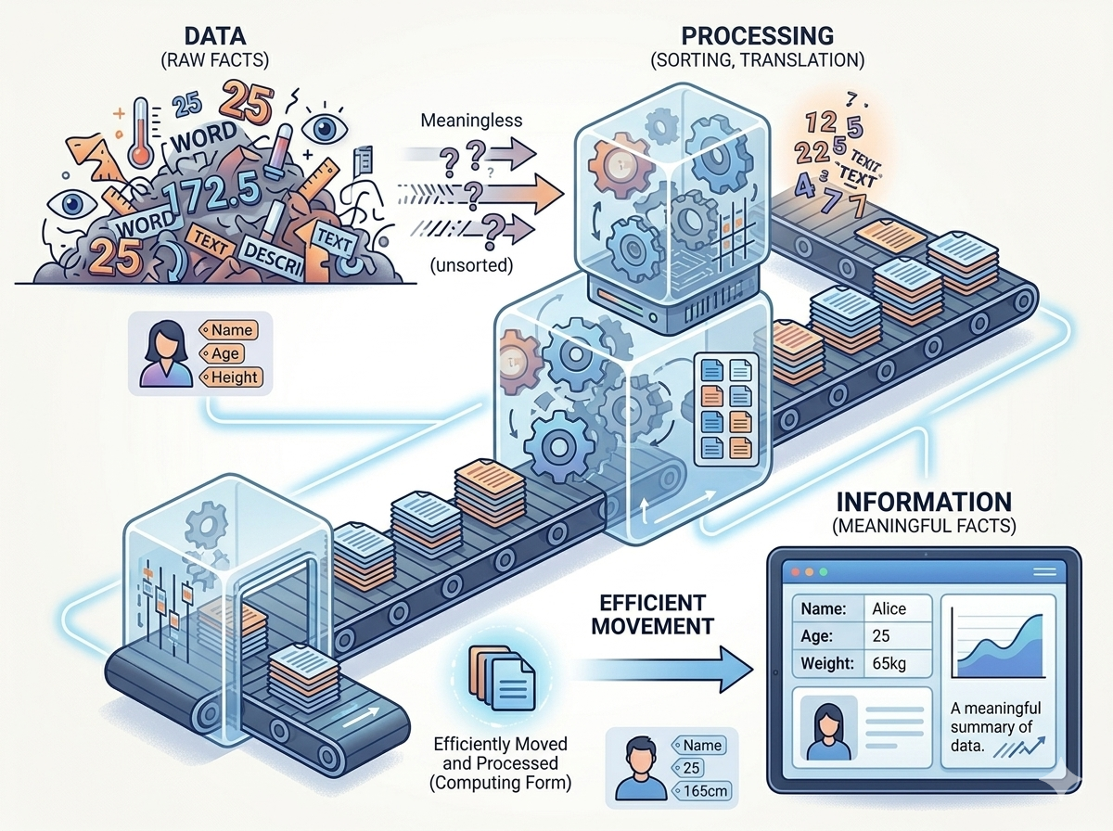
Introduction to DBMS
A DBMS (Database Management System) is software that enables:
Storage
Retrieval
Management of data
Examples: MySQL , Oracle Database , MongoDB, etc
Notes:
Database Management System is a software application used to access, create, and manage databases.
A DBMS consists of a group of commands to manipulate the database and acts as an interface between the end-users and the database.
Provides a way to store and retrieve data in both convenient and efficient manner.
Examples: Oracle, SQL Server, MySQL etc.
Database Management Systems allows users to do the following:
Define Data – Allows the users to create, modify and delete the definitions which define the organization of the database.
Update Data – Provides access to the users to insert, modify and delete data from the database.
Retrieve Data – Allows the users to retrieve data from the database based on the requirement.
Administration of users – Registers the users and monitors their action, enforces data security, maintains data integrity, monitors performance and deals with concurrency control.

Slide 6
Purpose of DBMS
To manage large volumes of data efficiently
Ensure:
Data consistency
Data security
Data integrity
Reduce redundancy Support multi-user environment
Efficient memory management and indexing
Concurrency control and transaction management
Access Control and ease in accessing data
Processing Queries and Object Management

Slide 7
Objectives and Evolution
Provide for mass storage of relevant data,
Make access to the data easy for the user,
Provide prompt response to user requests for data,
Make the latest modifications to the database available immediately,
Eliminate redundant data,
Allow for multiple users to be active at one time,
Allow for growth in the database system,
Protect the data from physical harm and unauthorized access.
Evolution of DBMS:
Year 1968: File based system
Year 1968 – 1980 : Hierarchical Database
Year 1960s : Network Data Model
Year 1970 – Present : Relational Database Management System, Object – based Database
For brief history, Go to the link below:
https://www.youtube.com/watch?v=8eYmdW9PBZc

Slide 8
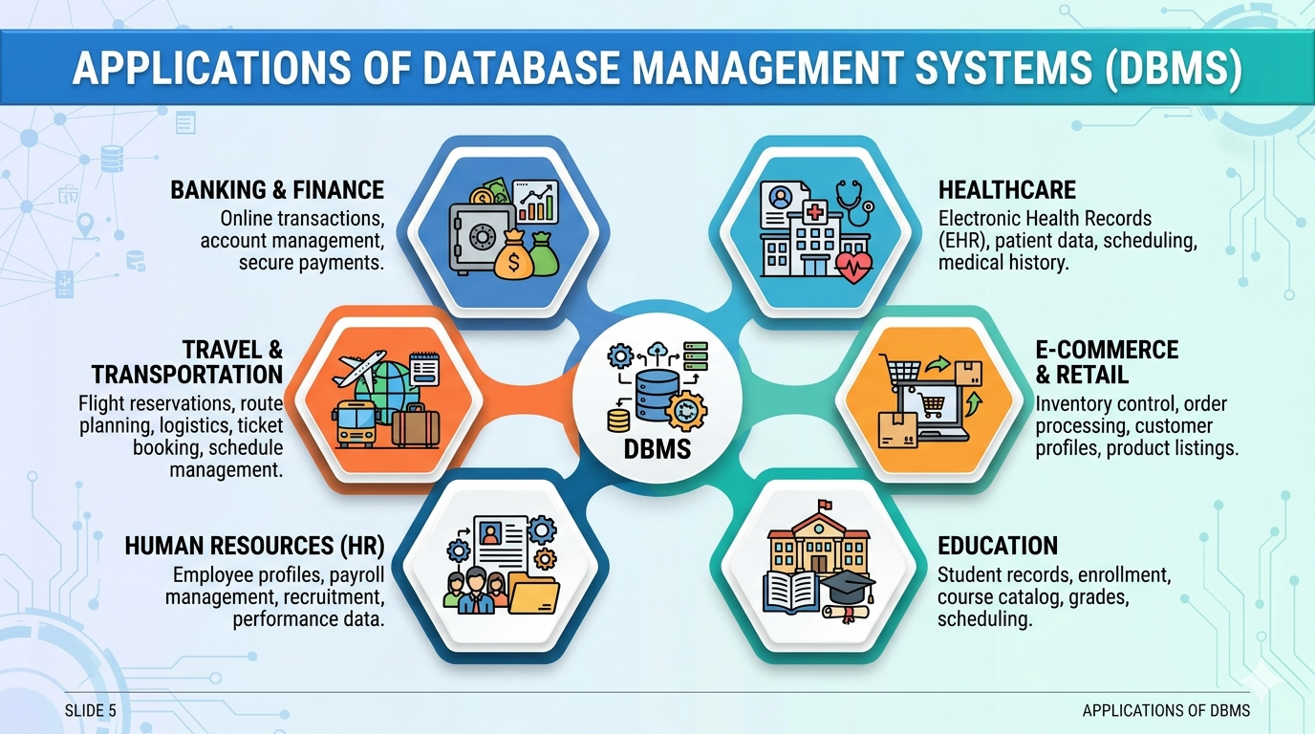
Application of DBMS
Notes:
1. Banking Systems
Role of DBMS in Banking
Banks handle millions of customer transactions daily. A DBMS helps manage customer accounts, transactions, loans, and financial records securely.
Major Applications
Customer account management
ATM transaction processing
Online banking services
Loan and credit management
Fund transfer systems
Fraud detection systems
Features Used
Data security
Transaction management
Backup and recovery
Multi-user access
Concurrency control
Example
When a customer withdraws money from an ATM:
DBMS checks account balance
Deducts amount
Updates account records
Stores transaction history
Benefits
Fast transaction processing
Reduced errors
Secure financial data
Real-time updates
2. Airline Reservation Systems
Role of DBMS in Airlines
Airline systems use DBMS to manage ticket booking, flight schedules, passenger information, and seat availability.
Major Applications
Ticket reservation
Flight scheduling
Passenger record management
Online check-in
Fare management
Crew scheduling
Features Used
Real-time database updates
Distributed databases
High availability
Multi-user transaction support
Example
When a passenger books a seat online:
DBMS checks seat availability
Reserves the seat
Processes payment
Updates passenger records instantly
Benefits
Prevents double booking
Fast reservation process
Accurate scheduling
Global access to booking systems
3. E-Commerce Platforms
Role of DBMS in E-Commerce
E-commerce websites store large amounts of customer, product, and order data. DBMS helps manage online shopping efficiently.
Major Applications
Product catalog management
Customer account management
Shopping cart systems
Payment processing
Inventory management
Order tracking
Features Used
Data consistency
Scalability
Security
High-speed querying
Example
In an online shopping website:
Customer searches products
DBMS retrieves product details
Order is placed
Inventory is updated automatically
Benefits
Faster online transactions
Personalized recommendations
Efficient inventory control
Secure customer information
4. University Systems
Role of DBMS in Universities
Educational institutions use DBMS to manage student, faculty, course, and examination records.
Major Applications
Student registration systems
Examination management
Attendance management
Library management
Course enrollment
Result processing
Features Used
Data sharing
Centralized storage
Multi-user access
Report generation
Example
During course registration:
Student logs into portal
DBMS checks course availability
Registers student
Updates class records
Benefits
Easy record management
Reduced paperwork
Faster result generation
Better academic management
5. Social Media Platforms
Role of DBMS in Social Media
Social media applications handle huge volumes of user-generated content and interactions.
Major Applications
User profile management
Friend/follower systems
Messaging systems
Post and media storage
Advertisement management
Recommendation systems
Features Used
Big data handling
Real-time processing
Distributed databases
Data indexing
Example
When a user uploads a photo:
DBMS stores image metadata
Updates user profile
Notifies followers
Maintains activity logs
Benefits
Fast content retrieval
Personalized user experience
Efficient data management
Real-time communication
6. Healthcare Systems
Role of DBMS in Healthcare
Hospitals and healthcare organizations use DBMS to manage patient records and medical operations.
Major Applications
Electronic Health Records (EHR)
Appointment scheduling
Laboratory management
Pharmacy management
Billing systems
Patient monitoring
Features Used
Data privacy and security
Backup and recovery
High reliability
Access control
Example
When a doctor accesses patient history:
DBMS retrieves medical records
Displays diagnosis and prescriptions
Updates treatment details
Saves new reports securely
Benefits
Improved patient care
Faster diagnosis
Reduced paperwork
Better hospital management

Slide 9
Database System vs File System
File System:
Data stored in files
No centralized control
High redundancy
Database System:
Structured data storage
Centralized control
Reduced redundancy
Drawbacks of filesystem ?
Notes:
Drawbacks of File system
• Data redundancy: Data redundancy refers to the duplication of data, let's say we are managing the data of a college where a student is enrolled for two courses, the same student details in such case will be stored twice, which will take more storage than needed. Data redundancy often leads to higher storage costs and poor access time.
• Data inconsistency: Data redundancy leads to data inconsistency, lets take the same example that we have taken above, a student is enrolled for two courses and we have student address stored twice, now let's say student requests to change his address, if the address is changed at one place and not on all the records then this can lead to data inconsistency.
• Data Isolation: Because data are scattered in various files, and files may be in different formats, writing new application programs to retrieve the appropriate data is difficult.
• Dependency on application programs: Changing files would lead to change in application programs.
• Atomicity issues: Atomicity of a transaction refers to “All or nothing”, which means either all the operations in a transaction executes or none.
• Data Security: Data should be secured from unauthorized access, for example a student in a college should not be able to see the payroll details of the teachers, such kind of security constraints are difficult to apply in file processing systems.

Slide 10
File Management System | Database management system
Easy-to-use system to store general files which require less security and constraints. | Is used when security constraints are high.
Data Redundancy is more in FMS | Data Redundancy is less in DBMS
Data Inconsistency is more in file system. | Data Inconsistency is less in DBMS
Centralization is hard to get when it comes to FMS | Centralization is achieved in DBMS.
User locates the physical address of the files to access data in FMS. | In DBMS, user is unaware of physical address where data is stored.
Security is low in FMS. | Security is high in DBMS.
FMS stores unstructured data as isolated data files/entities. | DBMS stores structured data which have well defined constraints and interrelation

Slide 11
Advantage of DBMS over file system
No redundant data
Data Consistency and Integrity
Data Security
Privacy
Easy access to data
Easy recovery
Flexible
So, what are disadvantages ?
DBMS implementation cost is high compared to the file system
Complexity: Database systems are complex to understand
Performance: Database systems are generic, making them suitable for various applications. However, this feature affect their performance for some application
Notes:
No redundant data: Redundancy removed by data normalization . No data duplication saves storage and improves access time.
• Data Consistency and Integrity: As we discussed earlier the root cause of data inconsistency is data redundancy, since data normalization takes care of the data redundancy, data inconsistency also been taken care of as part of it
• Data Security: It is easier to apply access constraints in database systems so that only authorized user is able to access the data. Each user has a different set of access thus data is secured from the issues such as identity theft, data leaks and misuse of data.
• Privacy: Limited access means privacy of data.
• Easy access to data– Database systems manages data in such a way so that the data is easily accessible with fast response times.
• Easy recovery: Since database systems keeps the backup of data, it is easier to do a full recovery of data in case of a failure.
• Flexible: Database systems are more flexible than file processing systems.

Slide 12
Storage Management
DBMS manages how data is stored on disk Components:
File organization
Buffer management
Disk space management
Goal: Efficient data retrieval

Slide 13
Indexing
Index improves speed of data retrieval Works like a book index Types:
Primary index
Secondary index
Hash index

Slide 14
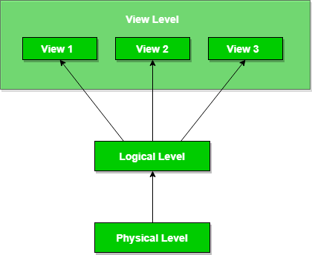
View of the data
DBMS hides complexity of data Provides multiple views to users
Highest level of data abstraction; describes the user interaction with database system.
Middle level of 3-level data abstraction architecture; describes what data is stored in database.
Lowest level of data abstraction; describes how data is actually stored in database. You can get the complex data structure details at this level.

Slide 15
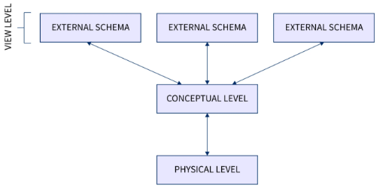
Data Abstraction Levels
Physical Level
How data is stored (lowest level)
2. Logical Level
What data is stored
3. View Level
What the user sees
Notes:
Example: Let’s say we are storing customer information in a customer table.
At the physical level, these records can be described as blocks of storage (bytes, gigabytes, terabytes, etc.) in memory. These details are often hidden from the programmers.
At the logical level, these records can be described as fields and attributes along with their data types, and their relationship among each other can be logically implemented. The programmers generally work at this level because they are aware of such things about database systems.
At the view level, users just interact with the system with the help of a GUI and enter the details on the screen, they are not aware of how the data is stored and what data is stored; such details are hidden from them.

Slide 16
Data Independence
Ability to modify schema without affecting applications
The main purpose of data abstraction is achieving data independence in order to save time and cost required when the database is modified or altered.
Data Independency can be defined as the capacity to change the schema at one level of a database system without having to change schema at the next higher level.
Both data abstraction and data independence hide implementation details from users.
This allow user to focus on the general structure rather than low-level implementation.
Types:
Physical Data Independence
Logical Data Independence

Slide 17
Data Independence
Logical data independence:
Ability to change the logical (conceptual) schema without changing the External schema (User View)
For example, the addition or removal of new entities, attributes, or relationships to the conceptual schema should be possible without having to change existing external schemas or having to rewrite existing application programs.
Physical data independence:
Ability to change the physical schema without changing the logical schema
For example, a change to the internal schema, such as using different file organization or storage structures, storage devices, or indexing strategy, should be possible without having to change the conceptual or external schemas.

Slide 18
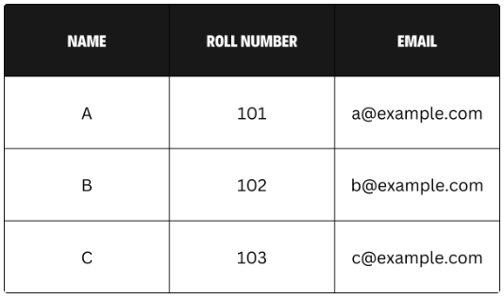
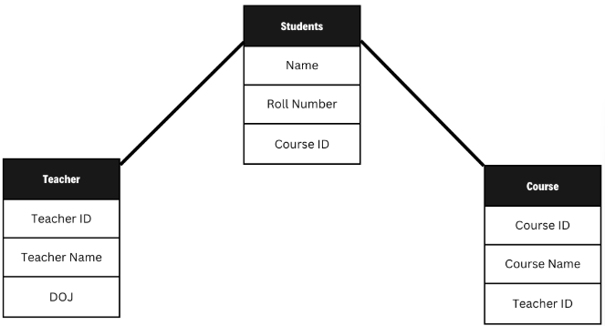
Instances and Schemas
Instance: Snapshot of database at a given time
Schema: Structure/design of database

Slide 19
Database Languages
DDL (Data Definition Language)
Defines structure
Commands: CREATE, ALTER, DROP
DML (Data Manipulation Language)
Manipulates data
Commands: INSERT, UPDATE, DELETE, SELECT
DCL (Data Control Language)
Controls access
Commands: GRANT, REVOKE
DDL → Structure (Shelves / Sheet design)
DML → Data (Books / Cell values)
DCL → Access (Who can use it)
TCL → Safety (Save or Undo)

Slide 20
DDL (Data Definition Language)
DDL is the short name of Data Definition Language, which deals with database schemas and descriptions of how the data should reside in the database.
CREATE - to create a database and its objects like (table, index, views, store procedure, functions, and triggers)
ALTER - alters the structure of the existing database
DROP - delete objects from the database
TRUNCATE - remove all records from a table, including all spaces allocated for the records
RENAME - rename an object
DDL commands are auto-commit (cannot be rolled back in most systems). They deal with structure, not data. Changes are permanent once executed.
Notes:
Creating a new bookshelf → CREATE TABLE
Adding a new section (e.g., Science) → ALTER TABLE
Removing a bookshelf → DROP TABLE
Clearing all books but keeping the shelf → TRUNCATE
You are designing the infrastructure, not handling individual books.
Excel Analogy
Creating a new sheet → CREATE
Adding/removing columns → ALTER
Deleting a sheet → DROP
Clearing all rows → TRUNCATE
You are modifying the layout of the sheet.

Slide 21
DDL
CREATE
CREATE TABLE table_name (
column1 datatype [constraint],
column2 datatype [constraint],
...
);
CREATE TABLE students (
id INT PRIMARY KEY,
name VARCHAR(50),
age INT
);
ALTER TABLE table_name
ADD column_name datatype;
ALTER TABLE students
ADD email VARCHAR(100);
ALTER
ALTER TABLE table_name
MODIFY column_name datatype;
ALTER TABLE table_name
DROP COLUMN column_name;
DROP
DROP TABLE table_name;
DROP TABLE students;
TRUNCATE
TRUNCATE TABLE table_name;
TRUNCATE TABLE students;
Notes:
1. CREATE
Used to create database objects like tables, schemas, indexes.
2. ALTER
Used to modify an existing table structure (add, modify, delete columns).
3. DROP
Used to delete an entire database object permanently.
4. TRUNCATE
Used to remove all records from a table quickly (faster than DELETE, no rollback in many DBMS).
5. RENAME
Used to rename a database object.
Syntax (varies by DBMS):
MySQL / Oracle:
RENAME TABLE old_name TO new_name;
SQL Server:
EXEC sp_rename 'old_name', 'new_name';

Slide 22
DML (Data Manipulation Language)
deals with data manipulation and includes most common SQL statements such SELECT, INSERT, UPDATE, DELETE, etc., and it is used to store, modify, retrieve, delete and update data in a database.
SELECT - retrieve data from a database
INSERT - insert data into a table
UPDATE - updates existing data within a table
DELETE - Delete all records from a database table
MERGE - UPSERT operation (insert or update)
Notes:
Library Analogy
Adding a new book → INSERT
Searching for books → SELECT
Updating book details → UPDATE
Removing a book → DELETE
You are interacting with books (data), not shelves.
Excel Analogy
Entering data in rows → INSERT
Filtering/searching rows → SELECT
Editing a cell → UPDATE
Deleting a row → DELETE
You are working with cell values.

Slide 23
DML
INSERT
INSERT INTO table_name (column1, column2, ...)
VALUES (value1, value2, ...);
INSERT INTO students (id, name, age)
VALUES (1, 'Kapil', 22);
SELECT column1, column2, ...
FROM table_name;
SELECT column1, column2
FROM table_name
WHERE condition;
SELECT
SELECT * FROM table_name;
SELECT name, age
FROM students
WHERE age > 20;
UPDATE table_name
SET column1 = value1,
column2 = value2
WHERE condition;
UPDATE
UPDATE students
SET age = 23
WHERE id = 1;
DELETE
DELETE FROM table_name
WHERE condition;
DELETE FROM students
WHERE id = 1;
Notes:
5. MERGE (Advanced / DBMS-specific)
Used to perform INSERT + UPDATE in a single statement (commonly in Oracle, SQL Server).
MERGE INTO target_table t
USING source_table s
ON (condition)
WHEN MATCHED THEN
UPDATE SET t.column = s.column
WHEN NOT MATCHED THEN
INSERT (columns) VALUES (values);

Slide 24
DCL (Data Control Language) and TCL (Transaction Control Language )
DCL includes commands such as GRANT and mostly concerned with rights, permissions and other controls of the database system.
GRANT - allow users access privileges to the database
REVOKE - withdraw users access privileges given by using the GRANT command
TCL deals with a transaction within a database.
COMMIT - commits a Transaction
ROLLBACK - rollback a transaction in case of any error occurs
SAVEPOINT - to roll back the transaction making points within groups
Notes:
Excel Analogy
Entering data in rows → INSERT
Filtering/searching rows → SELECT
Editing a cell → UPDATE
Deleting a row → DELETE
You are working with cell values.
Excel Analogy
Giving someone edit/view access → GRANT
Removing access → REVOKE
Restricting editing → DENY
Think of sharing permissions in Google Sheets/Excel.
TCL (Transaction Control Language)
Library Analogy
Issuing multiple books and confirming → COMMIT
Canceling the transaction → ROLLBACK
Holding a checkpoint during issuing → SAVEPOINT
Like saying: “Finalize all issued books” or “Cancel everything.”
Excel Analogy
Saving the file → COMMIT
Undo (Ctrl + Z) → ROLLBACK
Creating a restore point/version → SAVEPOINT
Controls when changes become permanent.

Slide 25
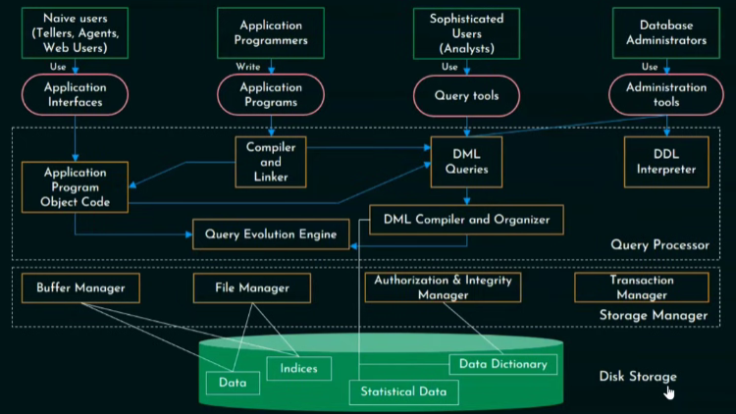
Database System Architecture
User Query
↓
Query Processor
↓
Storage Manager
├Buffer Manager → Loads data into RAM
├File Manager → Finds physical files/pages
├Transaction Manager → Ensures safe execution
└ Authorization & Integrity Manager → Checks permissions/rules
↓
Disk Storage
Notes:
Real-Life Analogy
DBMS Real Life
Disk Storage Warehouse
RAM Buffer Study table
Buffer Manager Person bringing books from warehouse to table
2. File Manager
Definition
The File Manager manages:
files
records
disk space allocation
physical organization of data
It controls how data is physically stored on storage devices.
Responsibilities of File Manager
1. File Organization
Determines how records are stored:
Sequential
Heap
Hashed
2. Disk Space Allocation
Allocates space for:
tables
indexes
logs
3. Record Management
Handles:
insertion
deletion
updating
retrieval
4. Page Management
Data is stored in units called:
Pages or Blocks
File manager organizes these pages.
5. Maintaining Index Files
Coordinates storage of:
B-tree indexes
Hash indexes
Real-Life Analogy
DBMSReal LifeFile ManagerLibrarian organizing bookshelvesFilesBooksPagesBook pages
3. Transaction Manager
Definition
The Transaction Manager ensures that database transactions are:
safe
consistent
reliable
Especially when:
multiple users access data simultaneously
system crashes occur
What is a Transaction?
A transaction is a logical unit of work.
Example:
Transfer Rs. 500 from A to B
Steps:
Deduct from A
Add to B
Both must happen completely.
Responsibilities of Transaction Manager
1. Ensuring ACID Properties
ACID Properties
PropertyMeaningAtomicityAll or nothingConsistencyDatabase remains validIsolationTransactions don't interfereDurabilityChanges persist permanently
2. Concurrency Control
Many users may access same data simultaneously.
Transaction manager prevents:
lost updates
inconsistent reads
Uses:
locking
timestamps
scheduling
3. Recovery Management
If system crashes:
rollback incomplete transactions
restore correct database state
Uses:
logs
checkpoints
4. Commit and Rollback
Commit
Makes changes permanent.
Rollback
Undoes changes if error occurs.
Real-Life Analogy
DBMSReal LifeTransaction ManagerBank supervisorTransactionMoney transferRollbackCancel failed transfer
4. Authorization and Integrity Manager
Definition
This component ensures:
Only authorized users access data
Database rules remain valid
It handles:
security
permissions
integrity constraints
Responsibilities
1. User Authorization
Controls:
who can access data
what operations are allowed
Example:
Teacher can enter attendance
Student can only view attendance
2. Access Control
Manages privileges like:
SELECT INSERT UPDATE DELETE
3. Authentication
Verifies user identity using:
username/password
tokens
authentication systems
4. Integrity Constraint Enforcement
Ensures database correctness.
Types of Integrity Constraints
Entity Integrity
Primary key cannot be NULL.
Referential Integrity
Foreign key must reference valid row.
Domain Integrity
Values must stay within allowed range.
Example:
Marks BETWEEN 0 AND 100
5. Preventing Unauthorized Modifications
Protects against:
accidental corruption
malicious changes
Buffer Manager
The buffer manager manages temporary storage of database pages in main memory to reduce disk access time.
File Manager
The file manager handles physical storage organization, disk allocation, and record management in the database.
Transaction Manager
The transaction manager ensures reliable execution of transactions while maintaining ACID properties.
Authorization and Integrity Manager
This manager controls user access permissions and enforces integrity constraints to maintain database security and correctness

Slide 26
Buffer manager
The Buffer Manager manages the movement of data between: Disk storage (slow)
And Main memory/RAM (fast)
It uses a temporary memory area called the buffer.
Why It Is Needed
Accessing HDD/SSD repeatedly is slow.
So DBMS:
Loads frequently used data into RAM
Keeps it temporarily
Reuses it when needed
This greatly improves performance.
Responsibilities of Buffer Manager
Bringing Data from Disk to Memory
Managing Buffer Pool
Replacing Old Pages
Writing Modified Data Back to Disk
Notes:
Responsibilities of Buffer Manager
1. Bringing Data from Disk to Memory
When data is needed:
Buffer manager loads required blocks/pages into RAM.
Example:
SELECT * FROM Student;
Required pages are fetched into memory.
2. Managing Buffer Pool
A buffer pool is a collection of memory pages reserved for DBMS.
The buffer manager:
Allocates memory pages
Frees unused pages
Reuses memory efficiently
3. Replacing Old Pages
If memory becomes full:
some pages must be removed.
Uses algorithms like:
FIFO
LRU (Least Recently Used)
4. Writing Modified Data Back to Disk
If data changes in memory:
it must eventually be saved permanently.
This is called:
Dirty Page Writing

Slide 27
File manager
The File Manager manages:
files
records
disk space allocation
physical organization of data
It controls how data is physically stored on storage devices.
Real life analogy
DBMS Real Life
File Manager Librarian organizing bookshelves
Files Books
Pages Book pages
Responsibilities of File Manager
1. File Organization
2. Disk Space Allocation
3. Record Management
4. Page Management
5. Maintaining Index Files
Notes:
Responsibilities of File Manager
1. File Organization
Determines how records are stored:
Sequential
Heap
Hashed
2. Disk Space Allocation
Allocates space for:
tables
indexes
logs
3. Record Management
Handles:
insertion
deletion
updating
retrieval
4. Page Management
Data is stored in units called:
Pages or Blocks
File manager organizes these pages.
5. Maintaining Index Files
Coordinates storage of:
B-tree indexes
Hash indexes

Slide 28
Transaction manager
The Transaction Manager ensures that database transactions are:
safe
consistent
reliable
Especially when:
multiple users access data simultaneously
system crashes occur.
What is a Transaction?
A transaction is a logical unit of work.
Example: Transfer Rs. 500 from A to B
Steps:
Deduct from A
Add to B
Both must happen completely.
Responsibilities of File Manager
1. File Organization
2. Disk Space Allocation
3. Record Management
4. Page Management
5. Maintaining Index Files
Notes:
Responsibilities of Transaction Manager
1. Ensuring ACID Properties
ACID Properties
Property Meaning
Atomicity All or nothing
Consistency Database remains valid
Isolation Transactions don't interfere
Durability Changes persist permanently
2. Concurrency Control
Many users may access same data simultaneously.
Transaction manager prevents:
lost updates
inconsistent reads
Uses:
locking
timestamps
scheduling
3. Recovery Management
If system crashes:
rollback incomplete transactions
restore correct database state
Uses:
logs
checkpoints
4. Commit and Rollback
Commit
Makes changes permanent.
Rollback
Undoes changes if error occurs

Slide 29
Database Application Architecture
The DBMS design depends upon its architecture. The basic client/server architecture is used to deal with a large number of PCs, web servers, database servers and other components that are connected with networks.
The client/server architecture consists of many PCs and a workstation which are connected via the network.
DBMS architecture depends upon how users are connected to the database to get their request done.

Slide 30
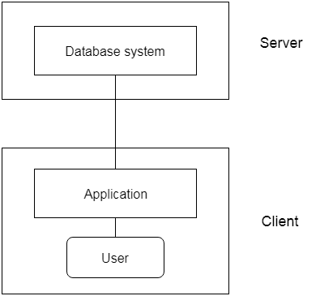
Two-Tier Architecture
Client directly communicates with database server
Example:
Desktop application
Advantages:
Simple
Disadvantages:
Less secure
Not scalable
Notes:
2-Tier Architecture
The 2-Tier architecture is same as basic client-server. In the two-tier architecture, applications on the client end can directly communicate with the database at the server side. For this interaction, API's like: ODBC, JDBC are used.
The user interfaces and application programs are run on the client-side.
The server side is responsible to provide the functionalities like: query processing and transaction management.
To communicate with the DBMS, client-side application establishes a connection with the server side.

Slide 31
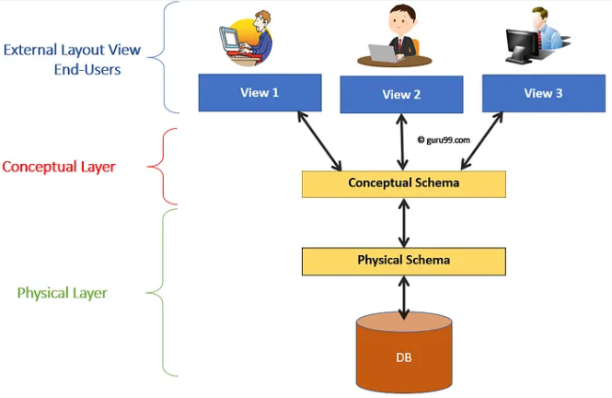
Three-Tier Architecture
Layers:
Presentation layer (UI)
Application layer (logic/ conceptual)
Database layer (physical layer)
Advantages:
More secure
Scalable
Better performance
Notes:
3-Tier Architecture
The 3-Tier architecture contains another layer between the client and server. In this architecture, client can't directly communicate with the server.
The application on the client-end interacts with an application server which further communicates with the database system.
End user has no idea about the existence of the database beyond the application server. The database also has no idea about any other user beyond the application.
The 3-Tier architecture is used in case of large web application.
Presentation tier
The presentation tier is the user interface and communication layer of the application, where the end user interacts with the application.
Its main purpose is to display information to and collect information from the user. This top-level tier can run on a web browser, as desktop application, or a graphical user interface (GUI), for example.
Web presentation tiers are usually developed using HTML, CSS and JavaScript. Desktop applications can be written in a variety of languages depending on the platform.
Application tier
The application tier, also known as the logic tier or middle tier, is the heart of the application. In this tier, information collected in the presentation tier is processed - sometimes against other information in the data tier - using business logic, a specific set of business rules.
The application tier can also add, delete or modify data in the data tier.
The application tier is typically developed using Python, Java, Perl, PHP or Ruby, and communicates with the data tier using API calls.
Data tier
The data tier, sometimes called database tier, data access tier or back-end, is where the information processed by the application is stored and managed.
This can be a relational database management system such as PostgreSQL, MySQL, MariaDB, Oracle, DB2, Informix or Microsoft SQL Server, or in a NoSQL Database server such as Cassandra, CouchDB or MongoDB.
In a three-tier application, all communication goes through the application tier. The presentation tier and the data tier cannot communicate directly with one another.
Advantages of Three-Level DBMS Architecture
Data Independence: Changes in physical storage or logical schema don’t affect user views and applications.
Enhanced Security: Users access only the data relevant to them, reducing exposure of sensitive information.
Flexibility: Multiple customized views can be created for different users without changing the underlying schema.
Simplified Design and Maintenance: Logical and physical designs are separated, making the system easier to manage and evolve.
Scalability: Structural changes at the internal level (like storage upgrades) don’t disrupt the overall system.
Disadvantages of Three-Level DBMS Architecture
Increased Complexity: Designing and managing three layers adds architectural complexity.
Performance Overhead: Multiple abstraction layers may introduce latency in data retrieval.
Higher Development Cost: More time and resources are needed to implement and maintain all three layers.
Not Ideal for Simple Applications: For small-scale systems, this architecture may be excessive and unnecessary

